Slide 1
PROJECT-8 Job Market Analysis and Recommendation System
Intern Name – Himanshu Manmode
For Next-Hikes IT Solutions
Project Submission Date 05.09.2025

Slide 2

Objective
The primary objective of this project is to analyze job market trends and build a recommendation system for job seekers based on real-time data
01
The System Will Help In Identifying-
High-demand Job Roles
Salary Trends
02
Emerging Job Categories
Personalized Job Recommendations
03

Slide 3
Situational Overview
The job market is dynamic and influenced by technological advancements, economic shifts, and cultural trends.
This project harnesses data analytics to
Understand job market dynamics
Provide actionable insights
Deliver predictions and recommendations for job seekers and recruiters

Slide 4
Project Tasks Overview
1. Correlation between job title keywords & salaries
2. Identify emerging job categories
3. Predict high-demand job roles
4. Compare hourly rates across countries
5. Build job recommendation engine
6. Track job market dynamics
7. Investigate remote work trends
8. Predict future job market trends

Slide 5
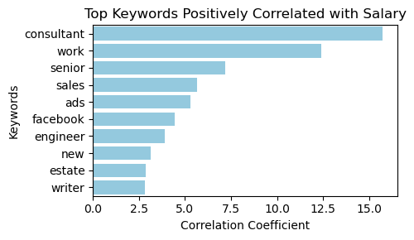
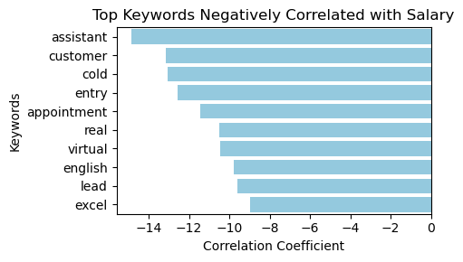
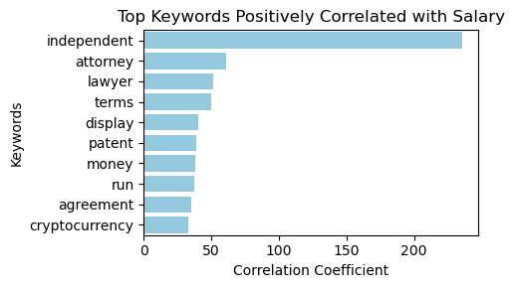
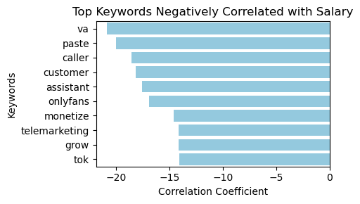
Task 1: Correlation between Job Title Keywords & Salaries
Objective: Find patterns between job title keywords and salaries.
Report with statistical analysis and visualizations.

Slide 6
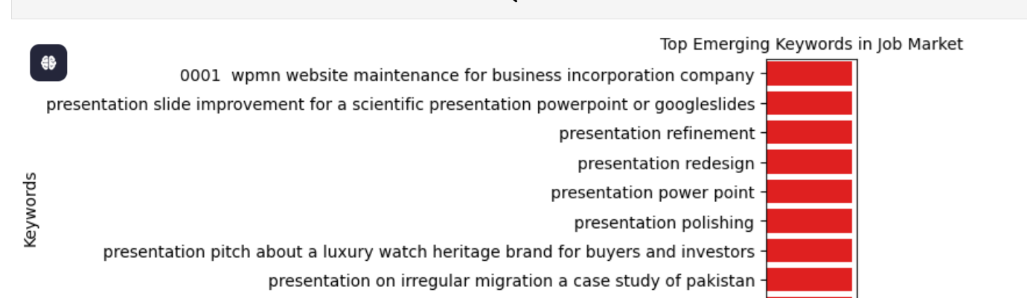
Task 2 Identify Emerging Job Categories
>
Objective: Analyze posting frequency to find emerging categories.
Deliverables: Growth analysis report with categories list.

Slide 7
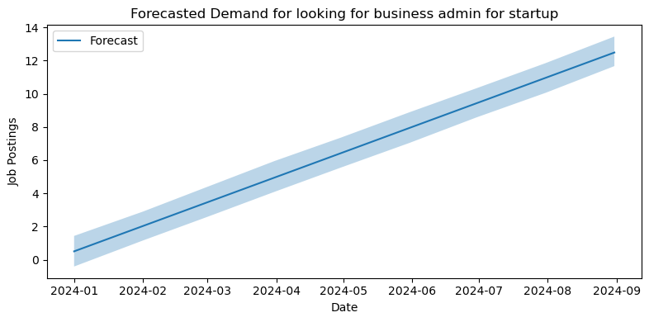
Task 3- Predict High-Demand Job Roles
Objective: Forecast job roles based on posting patterns.
Deliverables: Predictive model, accuracy metrics, demand trend visualization.

Slide 8
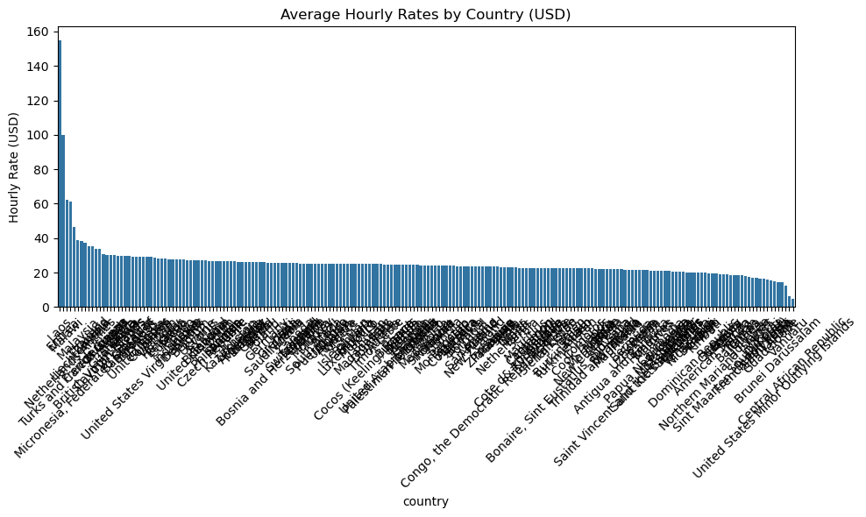
Task 4- Compare Hourly Rates Across Countries
Objective: Compare hourly rates across countries.
Deliverables: Interactive map or chart showing rates by country.

Slide 9
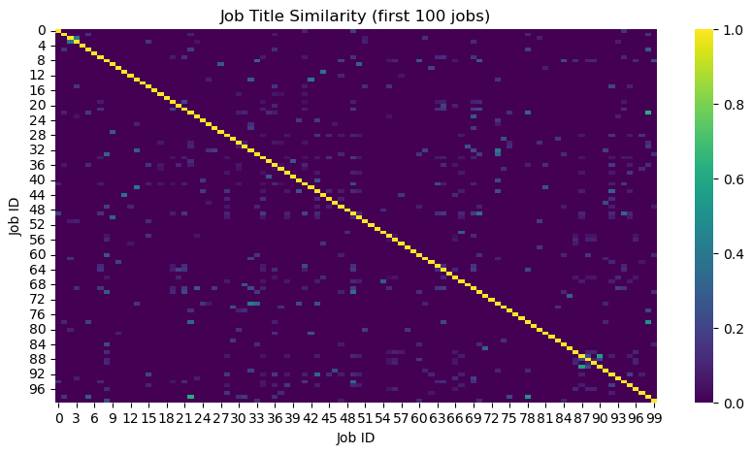
Task 5: Job Recommendation Engine
Objective: Develop personalized recommendation engine.
Deliverables: Prototype, API documentation, and UI for interaction.

Slide 10
CONCLUSION
This project provides a multi-faceted view of the job market through
Data analysis & predictive modeling
Personalized job recommendations
Streamlit App Deployment
Deliverables- Reports, models, dashboards, and a user-friendly web app.

Slide 11

THANK YOU
“The future belongs to those who can interpret data today and act wisely tomorrow.”

